Slide 1
AI Voice Agents Are Ready to Take Your Call
Week 16 Ed Elowson AI Voices

Slide 2
Link To The Source
https://www.wsj.com/articles/ai-voice-agents-are-ready-to-take-your-call-a62cf03b

Slide 3
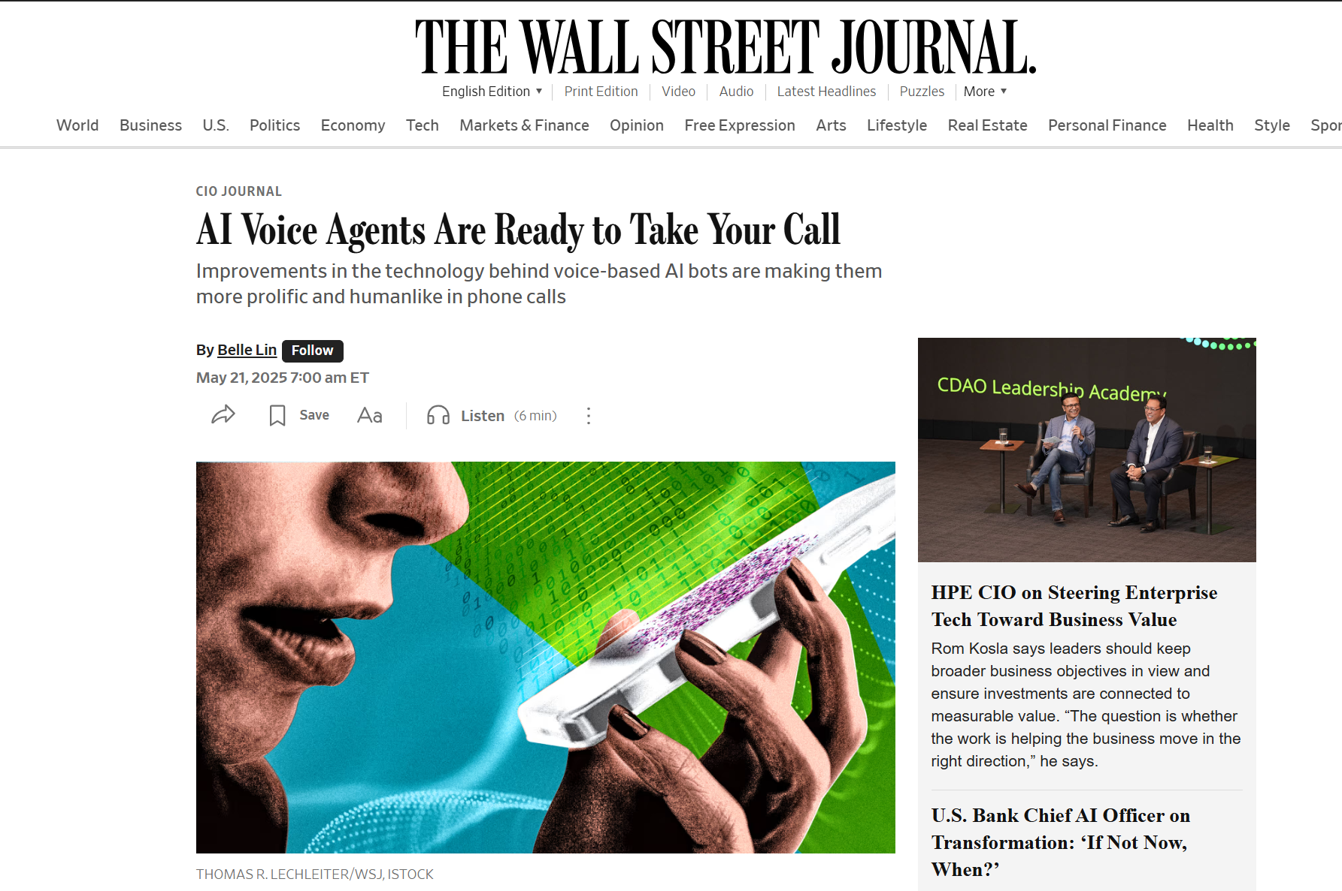
Screenshot

Slide 4
Main Findings
The article explains how advances in artificial intelligence are rapidly transforming customer-service voice bots into highly realistic conversational agents. Unlike traditional automated phone systems that relied on rigid scripts and limited responses, newer AI voice systems combine speech-to-text, text-to-speech, and large language models to create more natural, humanlike interactions. Companies such as eHealth and Fertitta Entertainment are already using AI voice agents to handle customer inquiries, reservations, and sales-related calls, particularly during periods of high call volume or after business hours. Industry experts cited in the article suggest that recent technological progress has accelerated faster than expected, with AI voices now capable of responding with little delay, handling interruptions, and making logical suggestions during conversations. The article also highlights major investment growth in the sector, with venture capital funding for voice AI startups increasing dramatically in recent years. However, businesses remain cautious about risks such as hallucinations, misinformation, privacy concerns, and determining when human interaction is still necessary.

Slide 5
Broader Implications for Society
The broader societal implications center on how AI voice systems may reshape communication, employment, and human interaction with technology. As AI-generated voices become increasingly indistinguishable from humans, the technology could significantly improve efficiency, reduce business costs, and provide faster customer service across industries such as healthcare, hospitality, and retail. At the same time, the article raises concerns about trust, transparency, and ethics, especially if consumers cannot easily distinguish between humans and AI during conversations. The growing use of AI voice agents may also alter workforce dynamics by automating repetitive call-center and customer-service roles while increasing demand for employees who can oversee, train, and manage AI systems. Additionally, the technology introduces risks involving misinformation, fraud, voice impersonation, and overreliance on automated systems. The article suggests that society is entering a transition where AI voices could become a standard part of everyday life, similar to chatbots and digital assistants, but where human oversight will remain essential for sensitive or high-stakes interactions.

Slide 6
Relevance and Potential Influence on the Construction Industry
For the construction industry, AI voice technology could improve communication efficiency, project coordination, and customer interaction across many operational areas. Construction firms, contractors, suppliers, and facility managers often manage large volumes of phone calls related to scheduling, procurement, inspections, maintenance requests, subcontractor coordination, and customer support. AI voice agents could automate routine communication tasks such as scheduling service appointments, providing project updates, coordinating deliveries, answering tenant or client inquiries, and routing urgent issues more efficiently. Voice-enabled AI systems may also support field operations by allowing workers to access project data, safety procedures, or equipment information hands-free while on-site. However, the article’s concerns about misinformation and hallucinations are especially important in construction, where incorrect instructions or inaccurate project information could create safety risks, delays, or costly errors. As AI voice tools become more advanced, construction companies will likely need clear governance policies, cybersecurity protections, and human oversight to ensure these systems improve productivity while maintaining safety, accountability, and trust in critical project communications.

Slide 7
